Slide 1
DATA ANALYTICS ON DEEPFAKE AND MISINFORMATION DATASET
Team Name: smusab9152
Rudra Dave | Musab Shaikh | Alina Pradhan

Slide 2
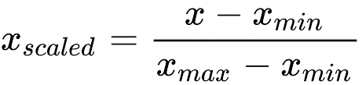
Data Overview and Data Wrangling
Data Overview:
The data consists of 19 columns and 1100 entries(rows) which includes Content Type, Social Media Platforms on which deepfakes were reported, Rate of Spread of the content Region(Continent), Action taken against the content, and many more
Data Wrangling:
Separating date and time from the Date Column
Created "Engagement Metric” column with summation of Engagement Likes, Shares and Comments columns
Created "Quarters" column from Date because data was only of a year.
Created Scale from 0 - 10 for columns 'Engagement Metric', 'Engagement Likes', 'Engagement Share', 'Engagement Comments' using Min-Max Normalization method, given below:
Click for updated dataset here: (Link)
FInd the notebook of the all the analysis here: (Link)

Slide 3
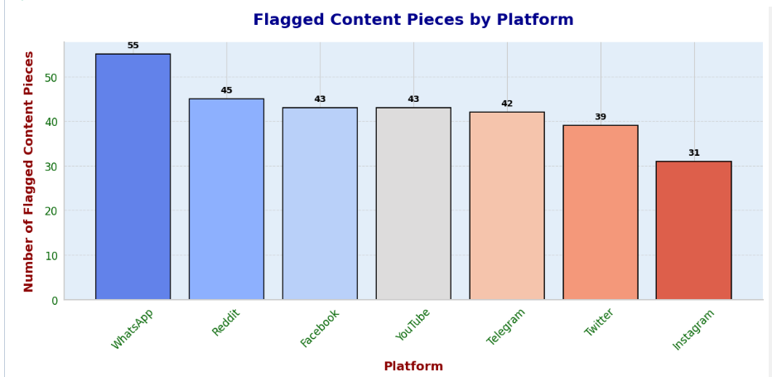
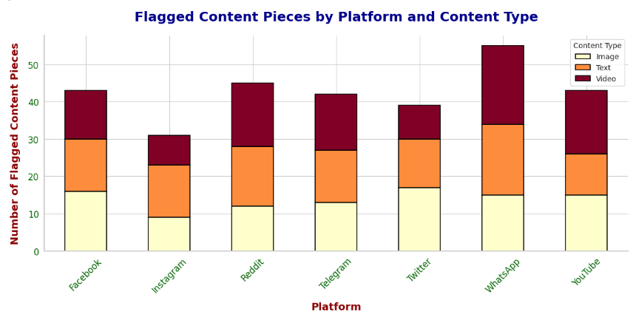
Data Visualization and Analysis
What is the total number of flagged content pieces for each platform?
WhatsApp leads with the highest flagged content (55 pieces), followed by Reddit and Facebook, while Instagram has the least (31). Text-based content is the most frequently flagged type across all platforms, with videos and images following. Platforms like WhatsApp and YouTube show a significant proportion of flagged text content. This underscores the prevalence of problematic textual content, especially on platforms with higher user engagement.

Slide 4
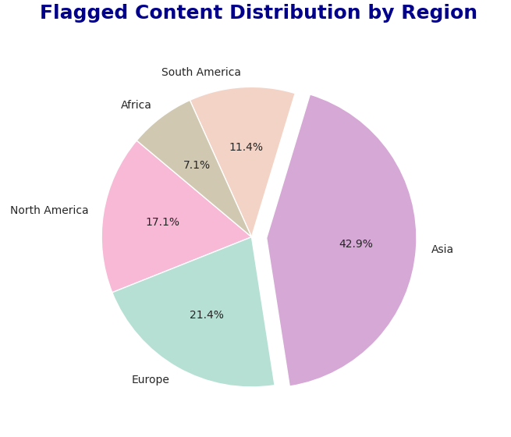
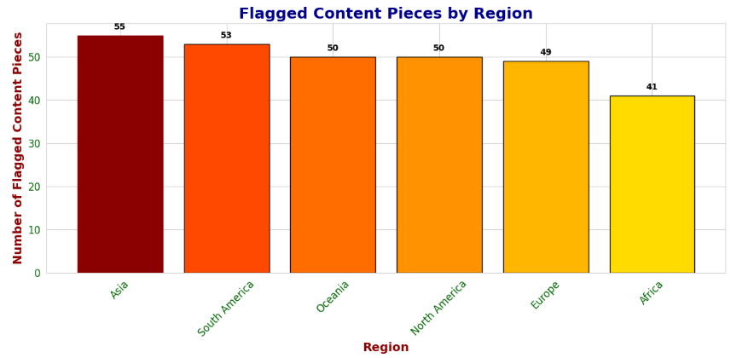
2. What is the total number of flagged content pieces for each platform?
Asia accounts for the highest proportion (42.9%) and the most flagged pieces (55), followed by South America (53) and Oceania (50). Africa has the least flagged content (41 pieces and 7.1%). This indicates that Asia faces the most significant flagged content issues, likely reflecting its high user base and activity,while Africa experiences comparatively lower flagged content concerns.

Slide 5
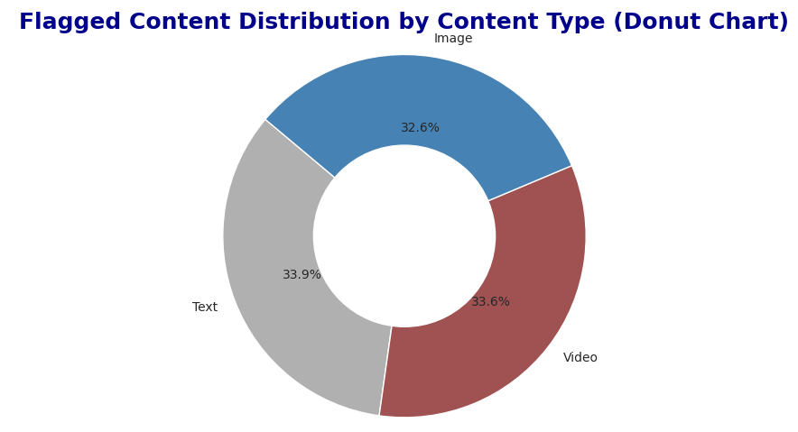
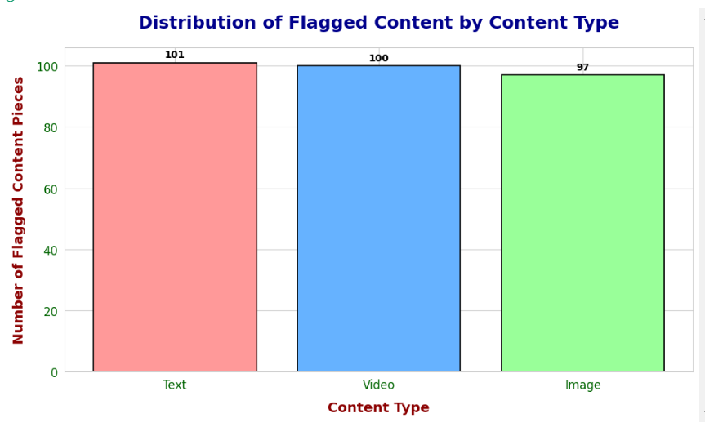
3. What is the distribution of flagged content by content type (text, image, video)?
The chart shows Text accounts for the largest share (33.9%, 101 pieces), followed closely by video (33.6%, 100 pieces), and image (32.6%, 97 pieces). The relatively balanced distribution indicates that all content types contribute significantly to flagged issues, with text being slightly more problematic.

Slide 6
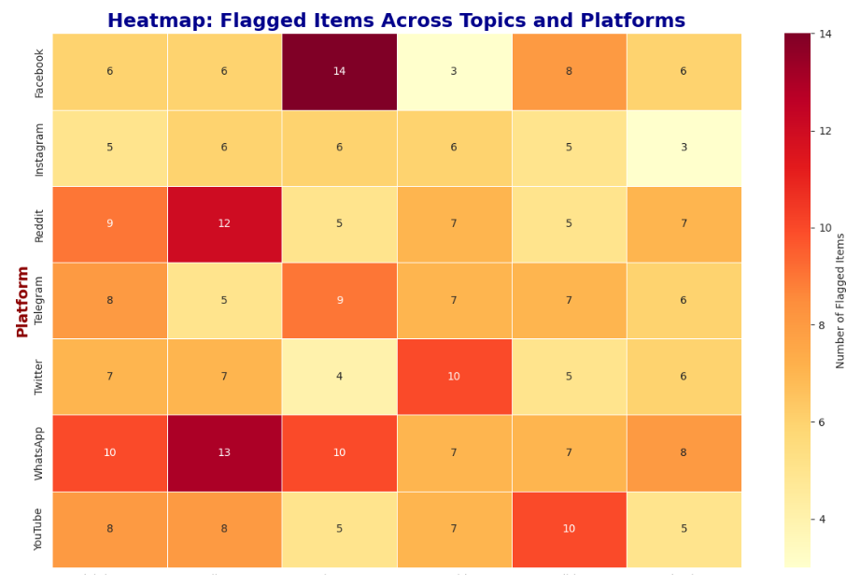
4. How many flagged content items belong to each topic (Health, Technology, Politics, etc.)?
The heatmap shows WhatsApp (13) and Facebook (14) have the highest number of flagged items, indicating these platforms are most problematic.
Overall, WhatsApp, Facebook, and Reddit emerge as platforms needing closer monitoring due to frequent flagged items.

Slide 7
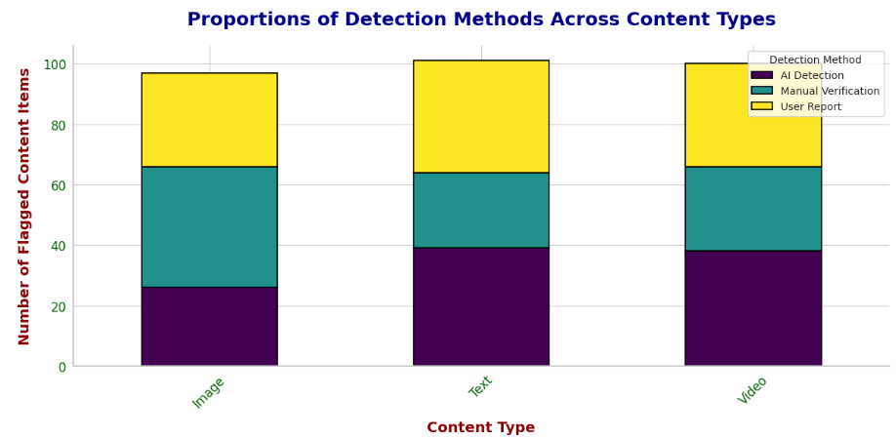
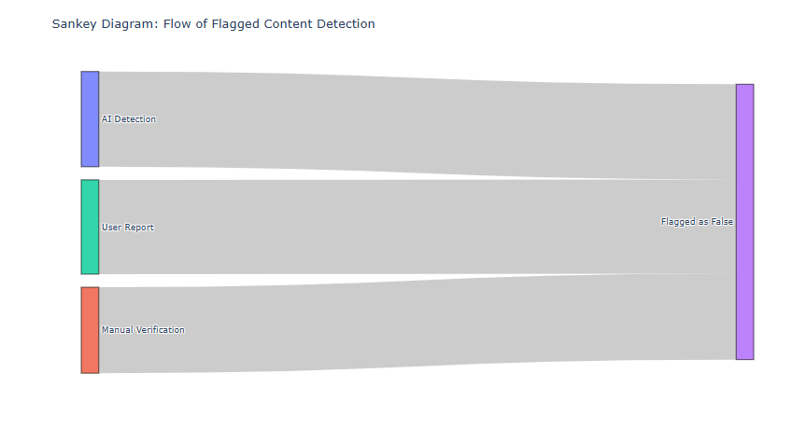
5. What is the most common detection method used for flagged content?
The bar chart shows AI Detection and User Reports as the main methods for flagging content, with Manual Verification contributing the least. User Reports are higher for Images and Videos, while AI remains consistent across all types. The Sankey diagram reveals that many flagged items, especially from AI Detection and User Reports, are eventually flagged as false. Overall, false positives remain a concern despite AI's dominance.

Slide 8
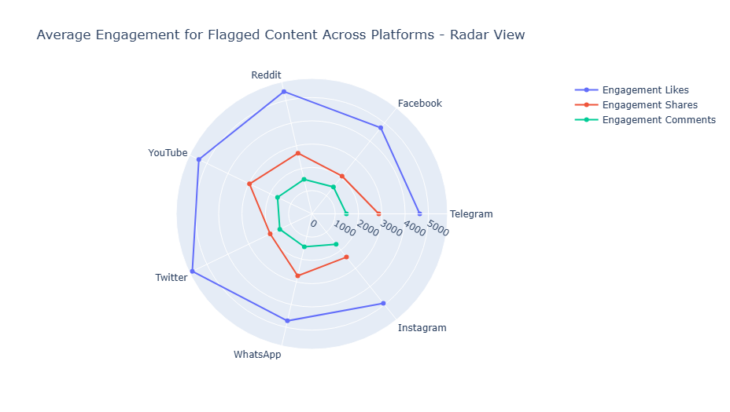
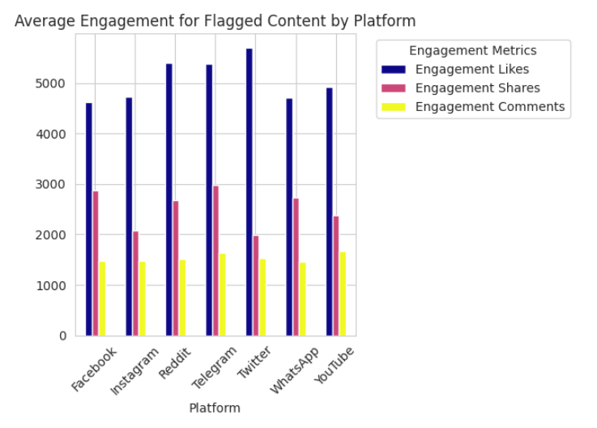
6. What is the average engagement (likes, shares, comments) for flagged content across platforms?
This analysis shows that Facebook and Reddit have the highest engagement for flagged content, while YouTube and Telegram have the lowest. Facebook leads in likes and shares, while Reddit leads in comments. WhatsApp has the lowest engagement overall.

Slide 9
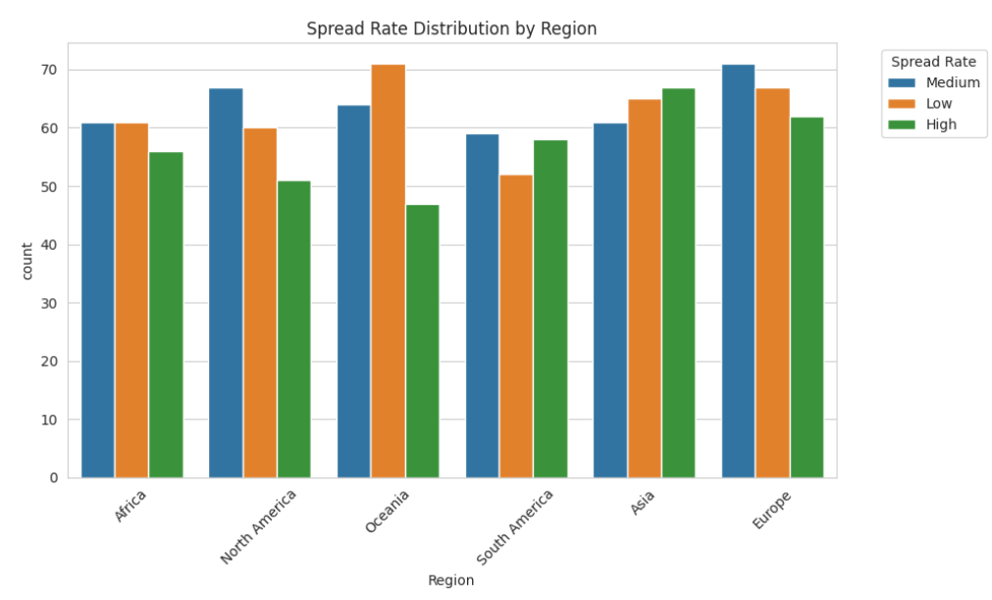
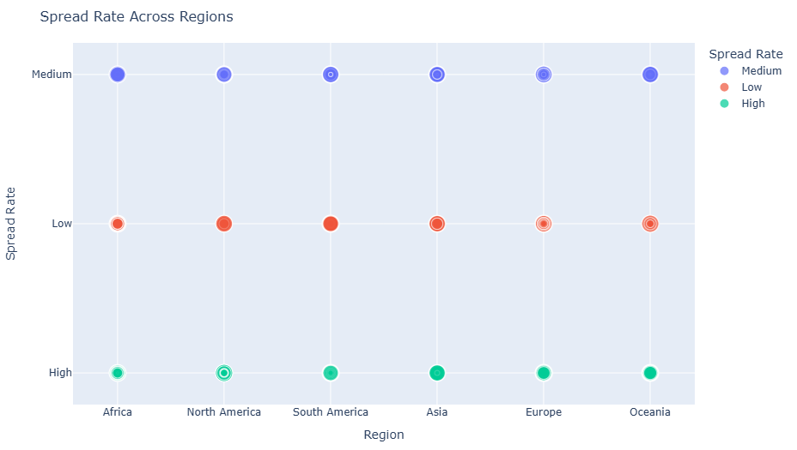
7. How does the spread rate vary across different regions?
This analysis shows that Europe and Asia have the highest number of regions with high spread rates, while Africa and North America have more regions with low spread rates. Oceania and South America have a more balanced distribution. This could be due to factors like healthcare systems, population density, and social factors.

Slide 10
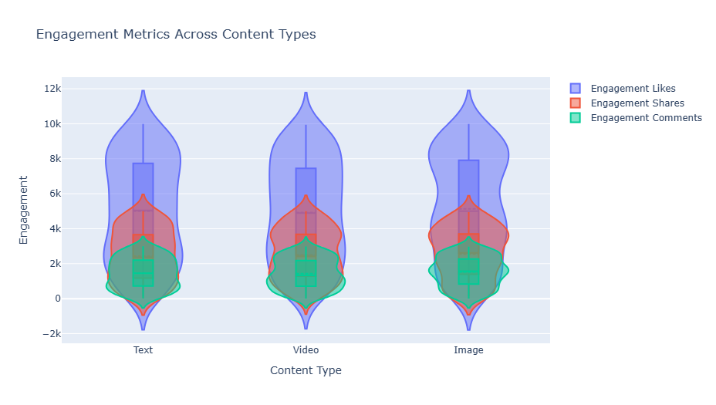
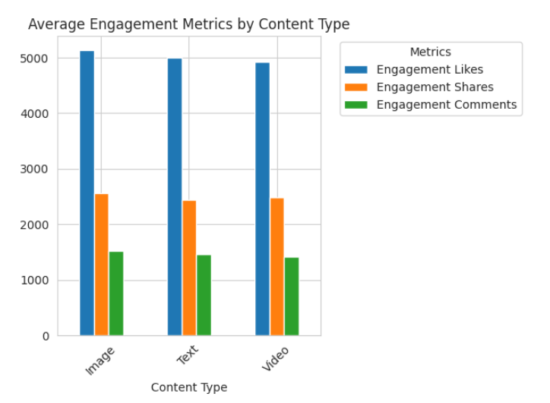
8. Is there a significant difference in engagement metrics (likes, shares, comments) across content types?
The analysis shows that video content consistently outperforms text and image content in terms of engagement across likes, shares, and comments. This is likely due to the visual appeal and shareability of video content.

Slide 11
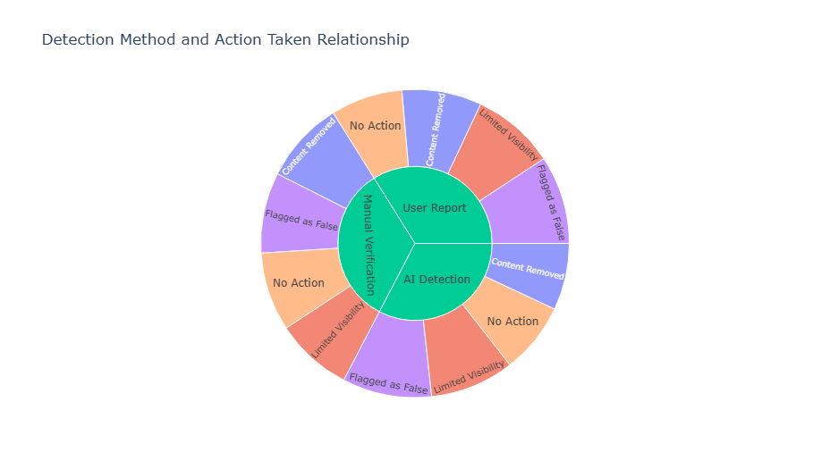
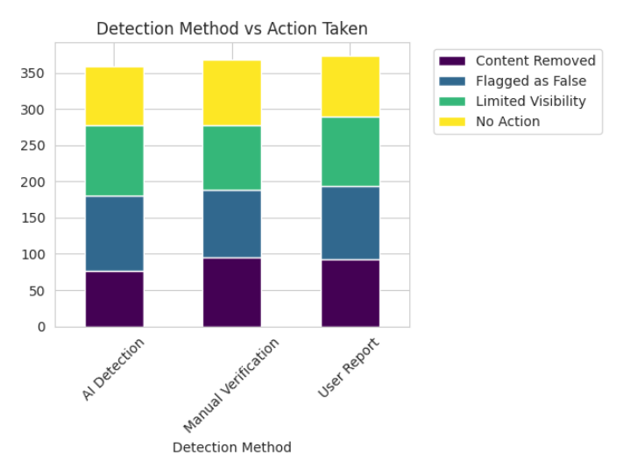
9.What is the relationship between the detection method used and the action taken (e.g., flagged, removed, limited visibility)?
The analysis shows that user reports lead to a variety of actions, including content removal, limited visibility, and flagging as false. AI detection is primarily used for content removal, while manual verification is less frequent and often leads to content removal or flagging as false.

Slide 12
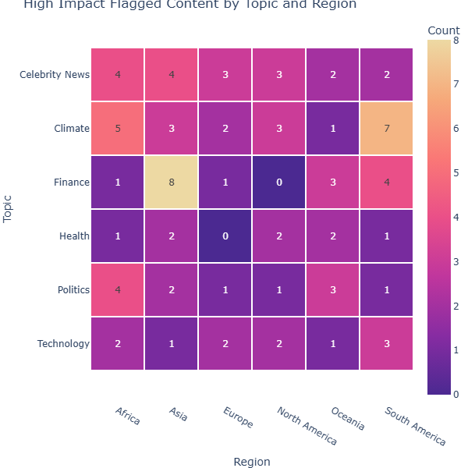
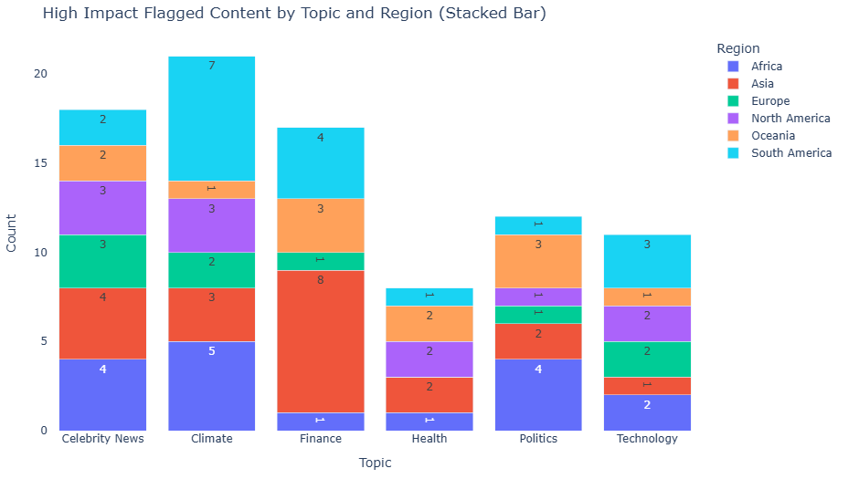
10 .Which topic has the highest proportion of flagged "High Impact" content, and how does it vary by region?
The analysis shows that celebrity news and climate are the top topics for high-impact flagged content across all regions. Finance and health have lower impact. The distribution of flagged content varies across regions.

Slide 13
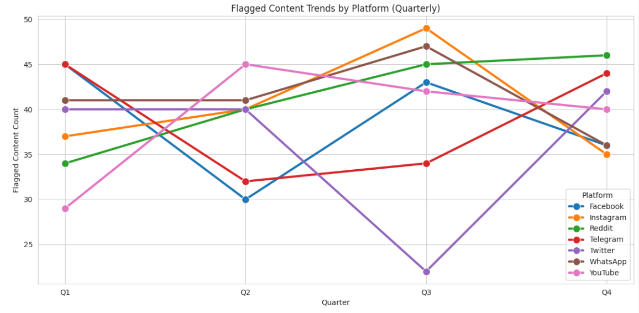
11. How do flagged content trends differ between platforms over time?
Instagram and Reddit have most misinformation in Q3, while Twitter sees the lowest flagged content in Q3 but a sharp uprise in Q4. Platforms like YouTube and Facebook show more fluctuation, whereas Reddit and WhatsApp exhibit a steady trend of misinformation throughout the year.

Slide 14
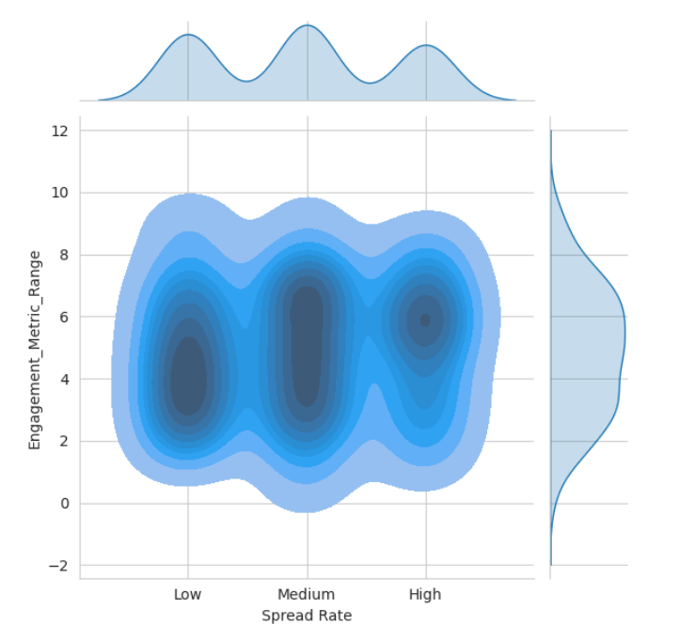
12. What is the correlation between spread rate and engagement (likes, shares) for flagged content?
Contour Plot: To find correlation between spread rate and engagement, We create a contour plot between Spread Rate and Engagement Metric Range
Engagement Metric Range has higher density peaks for Medium and High Spread Rates, suggesting that more engagement occurs as content spreads at faster rates.
Low Spread Rate shows lower density in engagement, meaning content with limited spread tends to have significantly lower engagement metrics overall

Slide 15
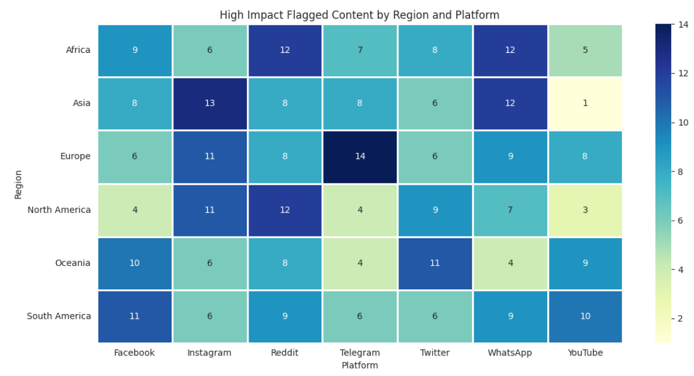
13. Which regions and platforms report the most "High Impact" flagged content, and how does engagement differ in these cases?
Europe has the highest flagged content, with 14 occurrences on Telegram, indicating that flagged content in Europe is concentrated on specific platforms.WhatsApp and YouTube show a balanced distribution of flagged content across all regions, while platforms like Instagram and Telegram have spikes in specific regions such as Asia and Europe.

Slide 16
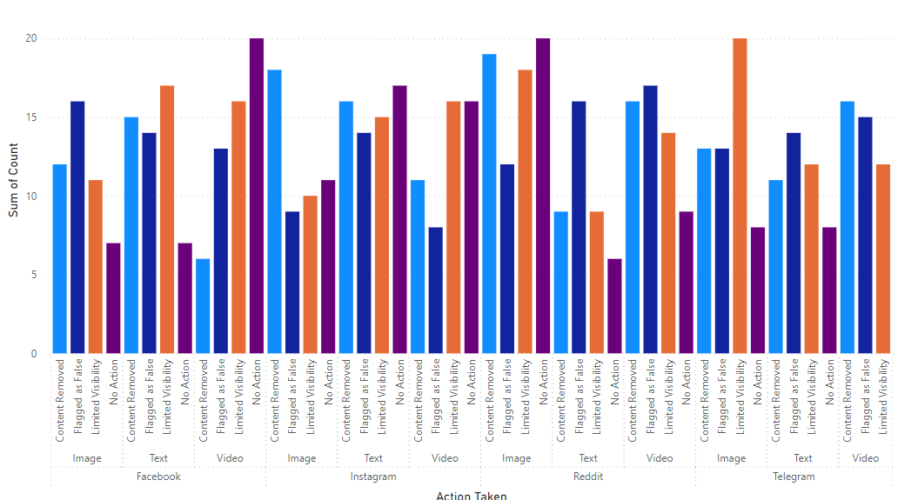
14. How does the action taken (e.g., flagged, removed) differ by content type and platform?
Facebook and Reddit show significant "Content Removed" actions for videos, while Telegram has higher "Limited Visibility" counts for text content.Instagram and Telegram appear to handle images more leniently with fewer "Content Removed" actions compared to Facebook.

Slide 17
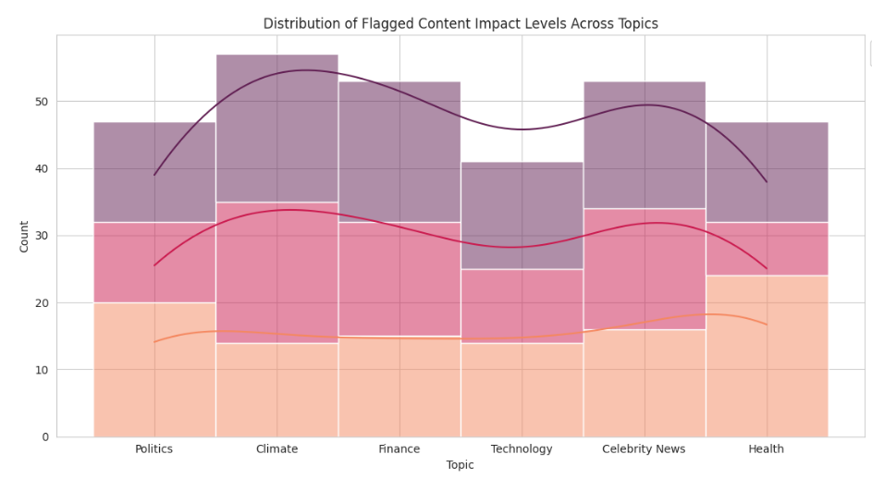
15.What is the distribution of flagged content impact levels across topics?
Climate and Celebrity News have the highest counts of flagged content, suggesting these topics are frequently scrutinized or reported for their impact levels.
Politics and Health display moderate flagged content levels,topics that includes Technology and Finance appear to have relatively fewer flagged instances.
The chart has 3 colors, maroon indicating high impact, red indication of moderate impact level and orange shows low impact level flagged content, along with the distribution, there is a kde line plotted to show the trend of the flagged content across the topics

Slide 18
Results and Insights
Platforms: WhatsApp, Reddit, and Facebook have the most flagged content; text is the dominant type.
Regions: Asia leads in flagged content; Europe and Asia have high spread rates, while Africa has the least flagged content.
Content Types: Videos drive the most engagement, while climate and celebrity news are the most flagged topics.
Detection and Actions: AI detection is effective but prone to false positives; user reports often lead to diverse actions like flagging or removal.
Engagement and Spread: High engagement correlates with faster spread rates; Facebook and Reddit lead in flagged content engagement.
Recommendations:
Platforms: Strengthen moderation on WhatsApp, Facebook, and Reddit, focusing on videos.
Regions: Target Asia and Europe with stricter policies; maintain low flagged levels in Africa with awareness.
Detection: Improve AI detection accuracy and integrate manual validation to reduce false positives.
Content: Focus on mitigating misinformation in videos, climate, and celebrity news topics.
Engagement: Analyze high-engagement content to preemptively address viral flagged cases.

Slide 19
THANK YOU!

